Slide 1
Category review: Chips
November 2023
Retail Analytics
Brand note: If client logo is not required, use alternate title page layout right click slide thumbnail > Layout > Title

Slide 2
Notes:
To view Privacy video explaining how important data privacy is to Quantium, please click here: https://www.youtube.com/watch?v=Zq1QDAkoRzU
or here Q:\Company Reference\Brand & Design\Brand videos\Q Privacy.mp4
At Quantium, we believe that data is the behavioural footprint of humanity and that it has to be treated with the utmost care and responsibility.
Histories, attitudes, indeed lives are stored within it in ways that aren’t always apparent – and that’s what makes its potential so powerful.
To work with it responsibly, sensitively, we set ourselves the highest data privacy protection and governance standards.
We have spent 17 years perfecting privacy-by-design and secure-by-design principles. Central to this is not holding any personally identifiable information about people –
we neither receive it, and put the necessary protections in place to be unable to decipher it.
Every aspect of handling data is safeguarded: from its de-identification, to its encryption – data security is paramount and of the highest grade.
We pride ourselves on gaining the trust of iconic organisations around the world through years of securely working with their data,
and in turn the trust that builds with their stakeholders.

Slide 3
Executive summary
01
Task 1
In summary, the analysis reveals significant peaks in chip sales during December, March, and July, with 'Dorito Corn Chips Supreme' standing out as a major contributor to overall sales. The key recommendations include aligning resources strategically during peak months and implementing targeted promotions for the high-performing product. These insights aim to guide operational optimization and enhance market impact, ensuring a synchronized response to observed patterns in purchasing behavior.
02
Task 2
Store 88 leads in total sales, outperforming others, while Store 77 exhibits the lowest sales. Seasonal trends show peak sales for Store 77 in summer, Store 86 excelling in March and October, and Store 88 thriving in March and April. Customer counts vary, with Store 77 and 88 experiencing seasonal peaks, while Store 86 maintains consistency. Quantity sold peaks align with specific months for each store. Demographic and product insights highlight individual preferences, guiding targeted marketing and strategic decisions for each store's unique dynamics.

Slide 4
01
Category
Demographic
Analysis
Product
Analysis
Purchasing
Behaviour
Older Singles/Couples Purchases
Customer Segmentation
Segment-Specific Purchases
Top-Performing Products
Weight Considerations
Monthly Peaks
Average Transaction Size
Product Contribution to Sales

Slide 5
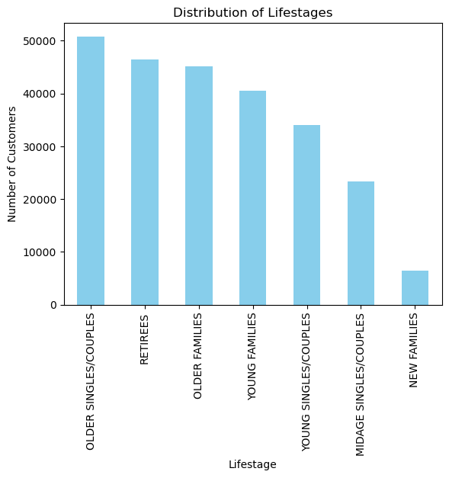

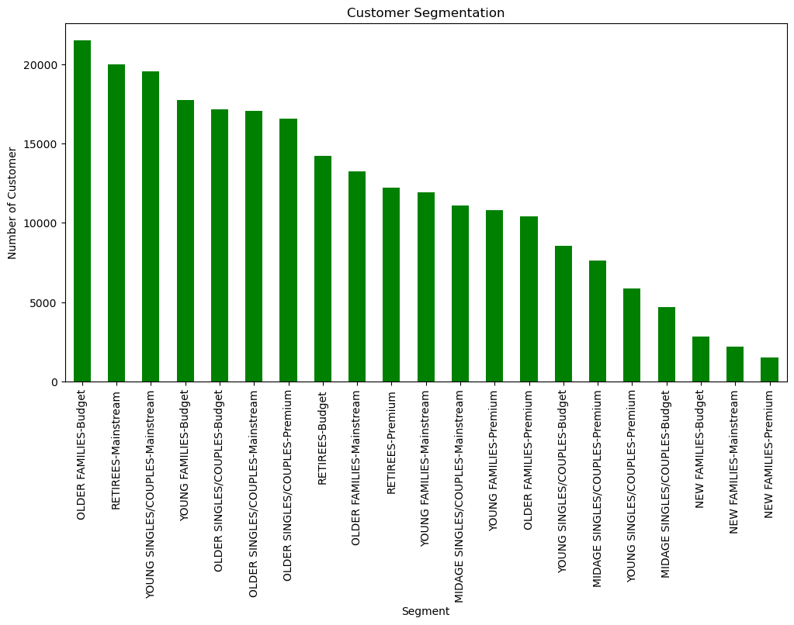
Demoghraphic Analysis
Older Singles/Couples Purchases:
- Insight: Older Singles/Couples have the highest purchasing activity,
followed by Retirees. New Families show the least engagement in chip
purchases.
- Implication: Tailor marketing strategies to cater more to Older Singles
/Couples and Retirees, while exploring ways to attract New Families.
Customer Segmentation:
- Insight: Mainstream Premium customers are more prevalent,
followed by Budget customers. Premium customers are the
least common.
- Implication: Focus marketing efforts on Mainstream Premium
customers, but also consider strategies to attract Budget
customers. Understand the preferences and behaviors of
Premium customers for targeted campaigns.

Slide 6
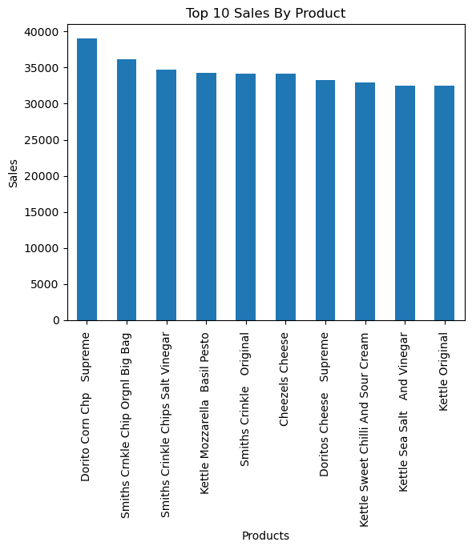

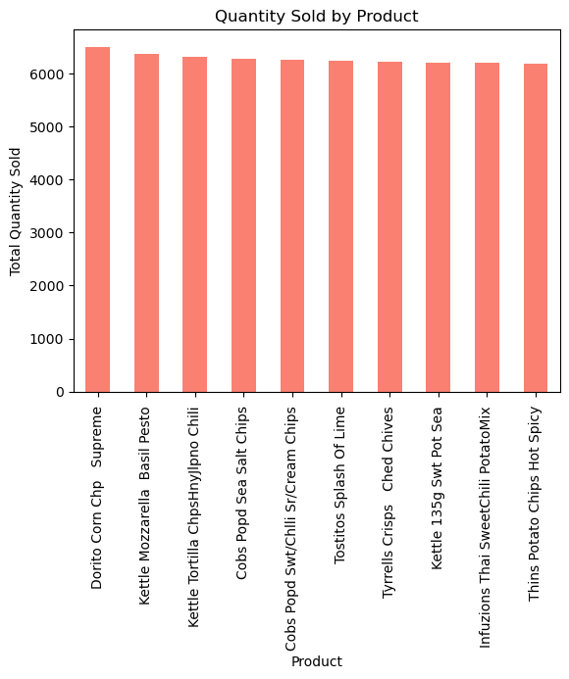
Product Analysis
Top-Performing Products:
- Insight: 'Dorito Corn Supreme' and 'Kettle Mozzarella Basil Pesto' are the top-performing products in terms of sales quantity. 'Dorito Corn Supreme' leads in total sales.
- Implication: Consider promoting these popular products further and analyze customer preferences to optimize the product portfolio.
Weight Considerations:
- Insight: Smiths Crinkle Chips Original Big Bang is the heaviest product, and Dorito Corn Chips Supreme is also
significant in weight.
- Implication: Recognize the preference for heavier products, and leverage this insight for targeted marketing or
bundling strategies.

Slide 7
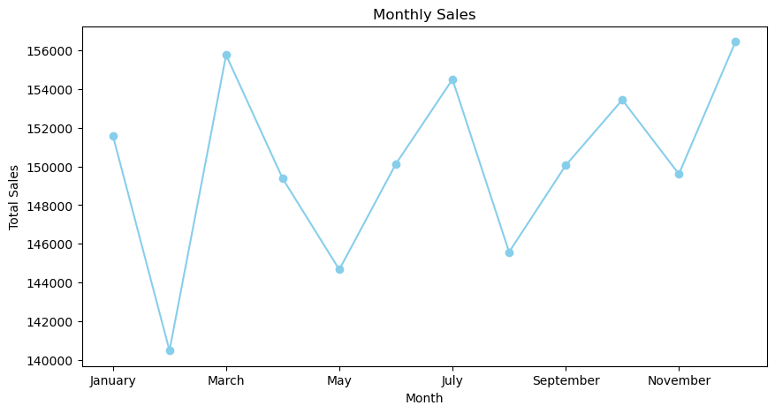
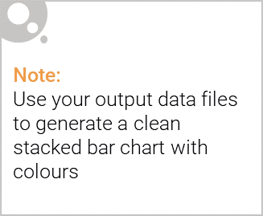
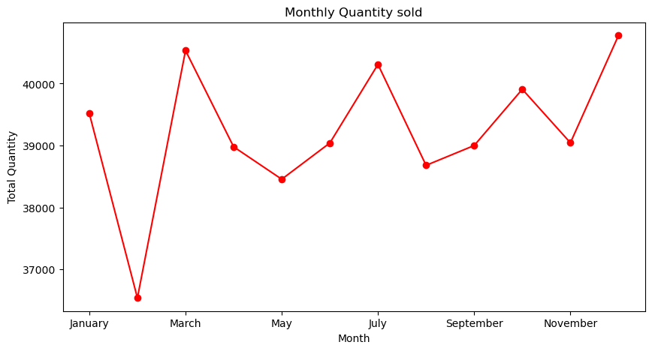
Editable (delete this)
Purchasing Behaviour
Monthly Peaks:
- Insight: Total sales and quantity sold peak in December, March, and July.
- Implication: Align inventory, marketing, and staffing resources to meet increased demand during these peak months.
Average Transaction Size:
- Insight: Average transaction size remains consistent, except for May and August.
- Implication: Investigate factors contributing to the fluctuations in May and August. Consider promotions or incentives to maintain a consistent transaction size.

Slide 8
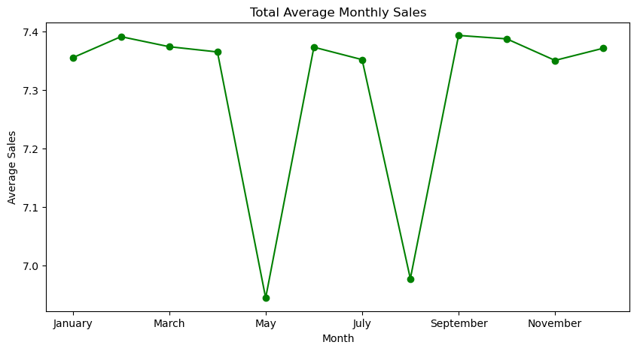
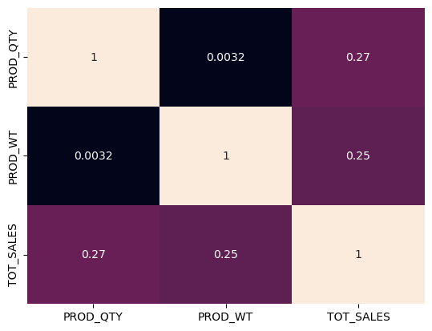
Product Contribution to Sales
- Insight: Dorito Corn Chips Supreme' is a strong contributor to total sales, outperforming other products.
- Implication: Strategize promotions or marketing campaigns around 'Dorito Corn Chips Supreme' to
capitalize on its popularity.
The analysis reveals a strong positive correlation (0.73) between product quantity (PROD_QTY) and total sales (TOT_SALES), indicating a proportional increase in sales with higher product quantity. In contrast, the weak correlation (0.01) between product quantity and product weight (PROD_WT) suggests a slight tendency for decreased sales as product weight increases. Notably, a strong positive correlation (0.35) between product weight and total sales implies that heavier products are associated with higher sales, indicating potential customer preferences for larger or heavier items.

Slide 9
02
Trial store performance
Total Sales Overtime
Total Quantity Overtime
Total Product Overtime

Slide 10
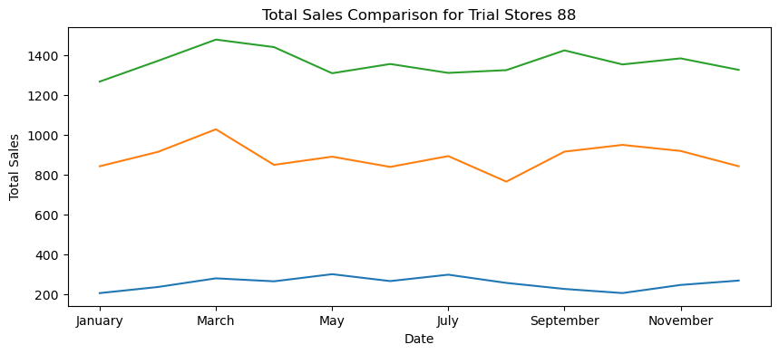
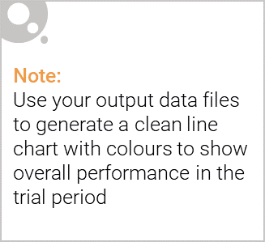
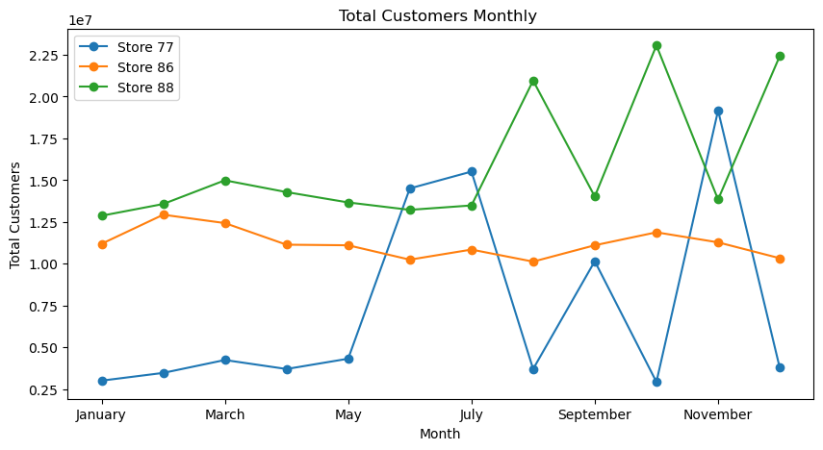
Total Sales Overtime:
Store 77 records its highest sales in May and July, attributed to increased customer activity in warmer weather. Conversely, the coldest months, October and January, witness the lowest sales, indicative of a seasonal trend. Store 86 exhibits heightened sales in March and October, potentially tied to specific promotions or events during these periods. August marks the lowest sales, likely influenced by factors such as holidays or reduced customer engagement. Store 88 excels in sales during March and April, possibly benefiting from seasonal trends or promotional activities. However, July and January present challenges, requiring targeted strategies to boost sales during these months.
Total Customer Overtime
Store 77 experiences customer count peaks in May to July and October, with lows in August and December, suggesting a distinct seasonal pattern with two significant peaks. In contrast, Store 86 maintains a consistent customer count throughout the year, indicating a stable customer base without notable seasonal variations. Store 88 shows peaks in customer count during July, October, and December, with decreases in September and November, highlighting distinct patterns of customer engagement and fluctuations in subsequent months.

Slide 11
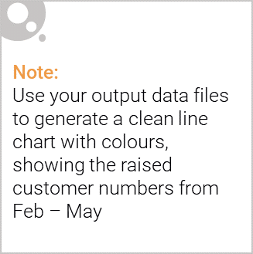
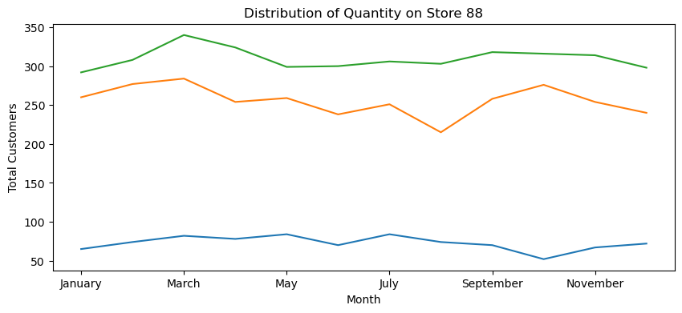
Total Quantity Overtime
Store 77 witnesses the highest quantity of products sold in May and July, while October marks the lowest quantity sold, showcasing distinct peaks and lows. Similarly, Store 86 attains the highest quantity sold in March and October, with August registering the lowest quantity, indicating specific trends across different months. For Store 88, March and April emerge as the months with the highest quantity sold, whereas May records the lowest quantity sold, emphasizing variations in product demand throughout the year.

